Slide 1
Overview of Java
Agenda
1) What is Java
2) Introduction to JDK,JVM,JRE
3) Install Java & Java IDE
4) Variable and data type
5) Operators
6) Flow Controll Statement
7) Function in Java Use
8) Arrays & String
9) OOP’s Concept
10) Construction
11) Packages & Access Specifier
12) Collection Framework

Slide 2

Cross Platform
Free(open Source)
Object Oriented

Slide 3
JDK,JVM,JRE
JDK: Java Development kit
JRE: Java Runtime Enviornment
JVM:Java Virtual Machine

Slide 4
Java Feature
Object Oriented
Platform Independent
Simple
Secure
Architeure Neutral
Portable
Robust
Multithreaded
Interpreted
High Performance

Slide 5
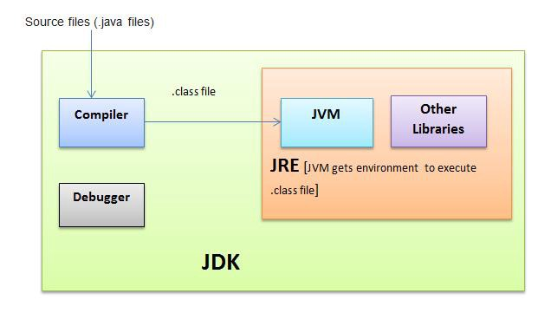

Slide 6
Java Program On CMD
public class MyFirstJavaProgram {
public static void main(String []args) {
System.out.println("Hello World");
}
}

Slide 7
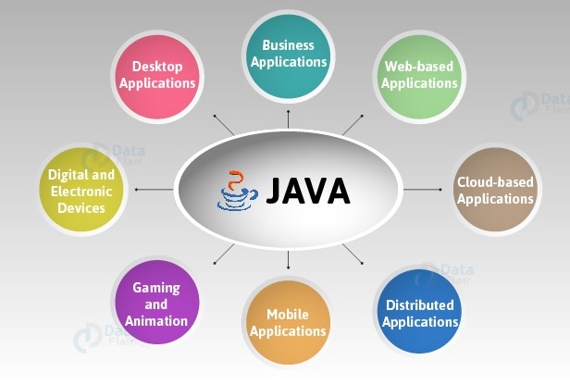
Where is Java Used

Slide 8
Java Runtime Enviroment(Oracle JDK & Open JDK)
About Oracle JDK
Personal user it is free
For business use,it need subsciprition which varries from $2.5/M to 25/M

Slide 9
Java Runtime Enviroment(Oracle JDK & Open JDK)
What is open JDK
Can be called a free JDK in General Public License(GNU Public License)
Oracle also provides open JDK 11 from Oracles open JDK Community. JDK java .net also available With LTS
1) like adoptopenjdk with LTS (IBM,AWS,amazon big names of suppo(LTS)
Amazon Corretto with LTS

Slide 10
Naming Convention in JAVA
Naming convention basically describe that how you can assign name to your identifiers such as class, package, variable, constant, method etc.
It is highly recommended for developer/programmers to follow naming convention while writing code.
All the classes, interfaces, packages, methods and fields of java programming language are given according to java naming convention.

Slide 11
Naming convention for different identifiers in JAVA
Class Name: Should start with uppercase letter and be a noun e.g. String, Color, Button, System, Thread etc.
example:
Class Student{
int rollNumber,marks;
String name;
}
Naming convention for different identifiers in JAVA:

Slide 12
Naming convention for different identifiers in JAVA
Interface Name: Should start with uppercase letter and be an adjective e.g. Runnable, Remote, ActionListener etc.
example
public interface ItemClickListener {
void onItemClick(View view, int position);
}

Slide 13
Naming convention for different identifiers in JAVA
Variable Name: Should start with lowercase letter e.g. firstName, secondName etc
example:
private void addNumbers(){
int firstNumber=10,secondNumber=20;
System.out.println(firstNumber+secondNumber);
}

Slide 14
Naming convention for different identifiers in JAVA
Package Name: Should be in lowercase letter e.g. java, lang, sql, util etc.
example:
p11ackage com.demo;
1

Slide 15
Naming convention for different identifiers in JAVA
Constant Name: Should be in uppercase letter e.g. RED, YELLOW, MAX_PRIORITY
example:
final int MAX_PRIORITY=5;
final String ACCOUNT_TYPE="saving";

Slide 16
Advantages of naming convention:
Easier
Rediability
Less time
Easier to understand
Grater consistency
Develop to maintain

Slide 17
Basic of Java
Variable
Operators
Expression
Statement
Block
Control Flow Statement
Input and Output Data
Arrays
Type casting

Slide 18
Variables
A variable is a container which holds the value while the Java program is executed. A variable is assigned with a data type.
1) Local variable
2) Static variable
3) Instance variable

Slide 19
Declaration
public class A
{
static int m=100;//static variable
void method()
{
int n=90;//local variable
}
public static void main(String args[])
{
int data=50;//instance variable
}

Slide 20
Java Variable Example: Add Two Numbers
public class Simple{
public static void main(String[] args){
int a=10;
int b=10;
int c=a+b;
System.out.println(c);
}
}
O

Slide 21
Local Variable
A local variable is a variable declared inside a method body, block or constructor. It means variable is only accessible inside the method, block or constructor that declared it.
Scope of local variable are limited to method. Such a variable is accessible only within the method or block in which it is declared. The local variable’s scope starts from the line they are declared and their scope remains there until the closing curly brace of the method comes.
Syntax Of Local Variable:
methodname(){
<DataType> localvarName;
}

Slide 22
Static Variable
Any variable when declared with the keyword “static” is known as static variable or class variable in JAVA. Static variable is used to fulfill the common properties of all objects.
The static variable gets memory at class loading time only once in class area.
Syntax of static variable:
static <DataType> <variable_name>;
For example:
Below age is a static variable.
static int age;

Slide 23
Instance Variable
An instance variable is a variable defined in a class (i.e. a member variable) in which each instantiated object of the class has a separate copy, or instance. An instance variable is similar to a class variable.
Instance variables belong to an instance of a class. It means instance variables belong to an object and we know that an object is an instance of a class. Every object has it’s own copy of the instance variables.

Slide 24
Operator In Java
Operator in Java is a symbol that is used to perform operations. For example: +, -, *, / etc.
There are many types of operators in Java which are given below:

Slide 25
Operator
ASSIGNMENT OPERATOR
ARITHMETIC OPERATOR
UNARY OPERATOR IN JAVA
EQUALITY AND RELATIONAL OPERATOR:
CONDITIONAL OPERATOR
TYPE COMPARISON OPERATOR
BITWISE AND BIT SHIFT OPERATOR

Slide 26
Assignment Operator
“=” is assignment operator in JAVA language which assign the value of its right side to its left side value. The right side value can be of variable, constant or expression that result some value and left side can be a variable or object which has the capacity to possess that right side value . It is evaluated from right to left.
Example of assignment operator:
int x = 5;

Slide 27
Assignment Operator
public class OperatorExample{
public static void main(String args[]){
int a=10;
int b=20;
a+=4;//a=a+4 (a=10+4)
b-=4;//b=b-4 (b=20-4)
System.out.println(a);
System.out.println(b);
}}

Slide 28
ARITHMETIC OPERATOR
There are 5 types of arithmetic operator in JAVA: addition (+), subtraction (-), division (/), multiplication (*) and remainder (%) operator.
Airthmetic Operator

Slide 29
Java Left Shift Operator
The left shift operator shifts all bits towards the left by a certain number of specified bits. It is denoted by <<.
Bits are shifted one position left and 0 is added to the last position
Java 1 bit Left Shift Operator

Slide 30
Number:
0010 : 2
0010.0

Slide 31
Expression,Statement,Block
Java Expression:
A Java expression consists of variables, operators, literals, and method calls. To know more about method calls, visit Java methods. For example,
int score;
score = 90;
Here, score = 90 is an expression that returns an int.

Slide 32
Java Expression
Double a = 2.2, b = 3.4, result;
result = a + b - 3.4;
Here, a + b - 3.4 is an expression.

Slide 33
Java Statements
In Java, each statement is a complete unit of execution. For example,
int score = 9*5;
Here, we have a statement. The complete execution of this statement involves multiplying integers 9 and 5 and then assigning the result to the variable score.
In the above statement, we have an expression 9 * 5. In Java, expressions are part of statements.

Slide 34
Expression statements
We can convert an expression into a statement by terminating the expression with a ;. These are known as expression statements. For example,
// expression
number = 10
// statement
Number = 10;
In the above example, we have an expression number = 10. Here, by adding a semicolon (;), we have converted the expression into a statement (number = 10;).

Slide 35
Java Block
class AssignmentOperator {
public static void main(String[] args) { // start of block
System.out.print("Hello Java ");
} // end of block
}
Here, we have block public static void main() {...}.
Here, inside the block we have one statements:
System.out.print("Hello Java ");

Slide 36
Java Basic Input and Output
You will learn simple ways to display output to users and take input from users in Java.
Java Output
In Java, you can simply use
System.out.println(); or
System.out.print();

Slide 37
to send output to standard output (screen).
Here,
System is a class
out is a public static field: it accepts output data.

Slide 38
Input and Output
A simple java program takes an input, process the input and produces the output as result.
Input can be taken from the keyboard, from a file, from main memory or from elsewhere. Now if the input is defined inside the program itself, then running it anytime would present us the same output.
In Order for an effective use of the program the input has to be received from outside of the program and hence IO functions are defined.

Slide 39
Streams:
Streams are used to handle input/output operations.
Stream is like a pipe which carries data from one end to the other. The end points are nothing but the source and destination of the data to be read/written.
Streams are classified into two types, which are the parent class of all the subclasses of other streams.
InputStream – Superclass of all classes used to read the input.
OutputStream – Superclass of all classes used to write the output.

Slide 40
There are 3 fields in System class which represents some stream.
in – Represents the standard input device
out – Represents the standard output device
err – same as System.out (Errors are displayed using this field.)

Slide 41
System.in field represents the InputStream object. Both System.out and System.err fields represents the PrintStream object.
To accept the data from the input device, we need to connect the System.in (representing the basic input device) to an input stream.
Example:
InputStreamReader object = new InputStreamReader(System.in);

Slide 42
tream class Description
BufferedInputStream Used for Buffered Input Stream.
BufferedOutputStream Used for Buffered Output Stream.
DataInputStream Contains method for reading java standard datatype
DataOutputStream An output stream that contain method for writing java standard data type
FileInputStream Input stream that reads from a file
FileOutputStream Output stream that write to a file.
InputStream Abstract class that describe stream input.
OutputStream Abstract class that describe stream output.
PrintStream Output Stream that contain print() and println() method

Slide 43
Java encapsulates Stream under java.io package. Java defines two types of streams. They are,
Byte Stream : It provides a convenient means for handling input and output of byte.
Character Stream : It provides a convenient means for handling input and output of characters. Character stream uses Unicode and therefore can be internationalized.

Slide 44
Java Input
Java provides different ways to get input from the user. However, in this tutorial, you will learn to get input from user using the object of Scanner class.
In order to use the object of Scanner, we need to import java.util.Scanner package.
import java.util.Scanner;
To learn more about importing packages in Java,

Slide 45
1) Java program to Add two Numbers
2) Even And Odd Number
3) Calculate simple interest
4) java program to find smallest of three number using ternary operator
5) to calculate discount of product programs (Discount=List prize * Discount)
Market price=200
Dis 20% =200*20%
A= market prize

Slide 46
example
import java.util.Scanner;
class Input {
public static void main(String[] args) {
Scanner input = new Scanner(System.in);
System.out.print("Enter an integer: ");
int number = input.nextInt();
System.out.println("You entered " + number);
// closing the scanner object
input.close();
}
}

